Slide 1
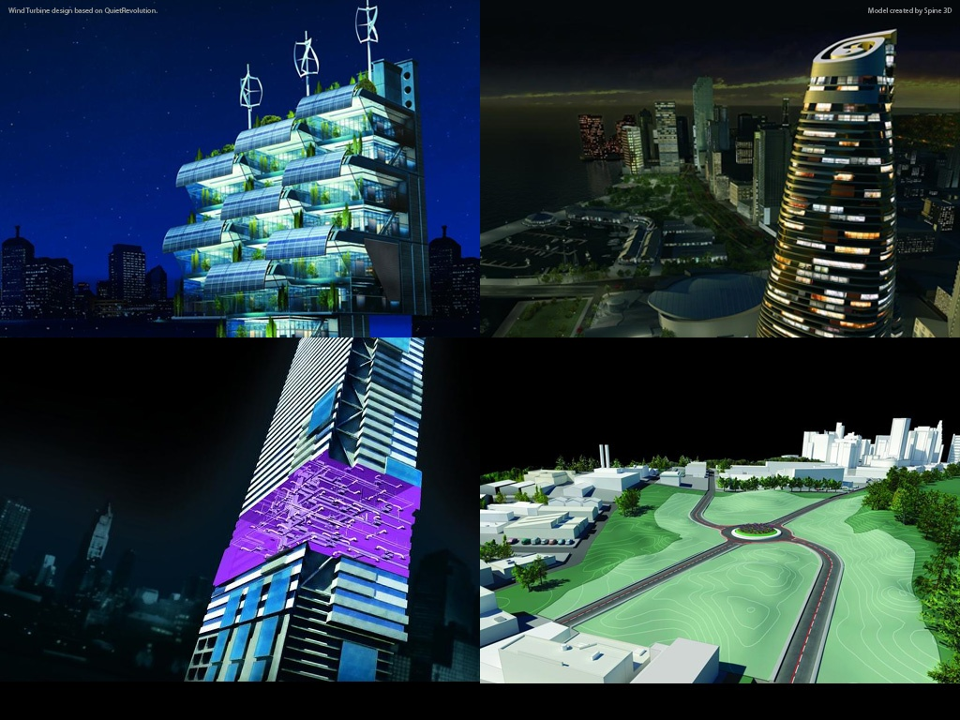
Introduction to Revit 2011 API Hands-on Training Class – July 2010
Jeremy Tammik
Developer Consulting
Developer Technical Services
Notes:
AEC Title

Slide 2
Before we start …
Background and Experience?
Name, Company?
Background (IT/programming/structure engineering)?
Revit Architecture/Structure/MEP?
Revit API?
VB.NET? C#?
AutoCAD, AutoCAD Architecture, etc. API’s?
ADN member?
…

Slide 3
Agenda
Day 1: Overview and Revit database basics
External command, external application, RevitLookup and RvtSamples setup, understanding the Revit element class, filtered element collector, object creation and modification
Day 2
FindMaterialTypeElements2
Developing something together following requests from the group
Revit UI basics: ribbon, dialog, selection
Event and dynamic modeling
Family API
Quick overview of other/advanced topics through samples
Custom data in shared parameters: FireRating
DocumentChanged event: ChangesMonitor
Dynamic Model Update (DMU): DynamicModelUpdate and DistanceToSurfaces
Analysis Visualisation Framework (AVF): DistanceToSurfaces and SpatialFieldGradient
Q&A
Notes:
We are running in low resolution today, so that we can switch back and forth between the presentation and live demos.
So, what are the initial steps in creating a Revit application?
The first thing is to understand is what is installed, the API architecture, the information provided and where to obtain more information.
Then we explore how to set up the development environment and create a first "Hello world" type application.
After that, we will look into the Revit database structure and its data and elements.
The samples provide a valuable knowledgebase on how to solve Revit programming tasks.
For the people who attended the recent webcast on the Revit Structure API on May 3rd, the current presentation covers the first half of that, all the generic material.

Slide 4
Revit API Intro Labs
Revit API fundamentals
Revit Add-ins: external command/application, attributes, add-in manifest and object model
Representation of Revit elements
Element iteration, filtering and queries
Element modification
Model creation
Exercises:
Lab1 – “Hello World”
Lab2 – DB element
Lab3 – element filtering
Lab4 – element modification
Lab5 – model creation

Slide 5
Questions & Answers

Slide 6
